Slide 1
CMSC204
Kartchner
V(StateGraph) = {Oregon, Alaska, Texas, Hawaii, Vermont, NewYork, California}
E(StateGraph) = {(Alaska, Oregon), (Hawaii, Alaska), (Hawaii, Texas), (Texas, Hawaii), (Hawaii, California), (Hawaii, New York), (Texas, Vermont), (Vermont, California), (Vermont, Alaska)}
1. Draw the StateGraph
Oregon Alaska
Texas Hawaii
Vermont New York California

Slide 2
a. Show the adjacency matrix that would describe the edges in the graph. Store the vertices in alphabetical order
States
Alaska
California
Hawaii
New York
Oregon
Texas
Vermont
0 | 0 | 0 | 0 | 1 | 0 | 0
0 | 0 | 0 | 0 | 0 | 0 | 0
11 | 1 | 0 | 1 | 0 | 1 | 0
0 | 0 | 0 | 0 | 0 | 0 | 0
0 | 0 | 0 | 0 | 00 | 0 | 0
0 | 0 | 1 | 0 | 0 | 0 | 1
1 | 1 | 0 | 0 | 0 | 0 | 0
3. b. Show the adjacency lists
that would describe the edges in the graph
A
B
C
D
E
F
G
B
A
A
A
C
C
A
C
C
B
F
G
D
E
D
E
G
F

Slide 3
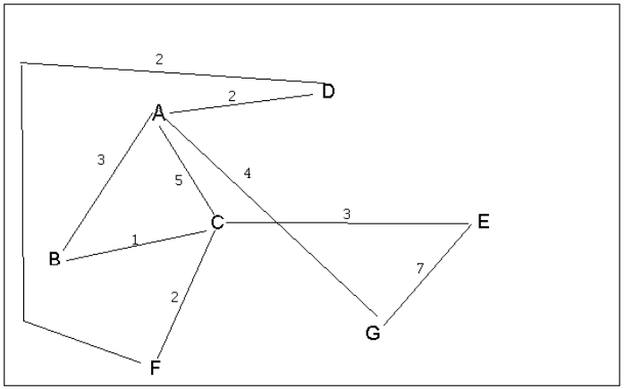
4 a. Which of the following lists the graph nodes in depth first order beginning with E?
A) E, G, F, C, D, B, A
B) G, A, E, C, B, F, D
C) E, G, A, D, F, C, B
D) E, C, F, B, A, D, G
4 b. Which of the following lists the graph nodes in breadth first order beginning at F?
A) F, C, D, A, B, E, G
B) F, D, C, A, B, C, G
C) F, C, D, B, G, A, E
D) a, b, and c are all breadth first traversals

Slide 4
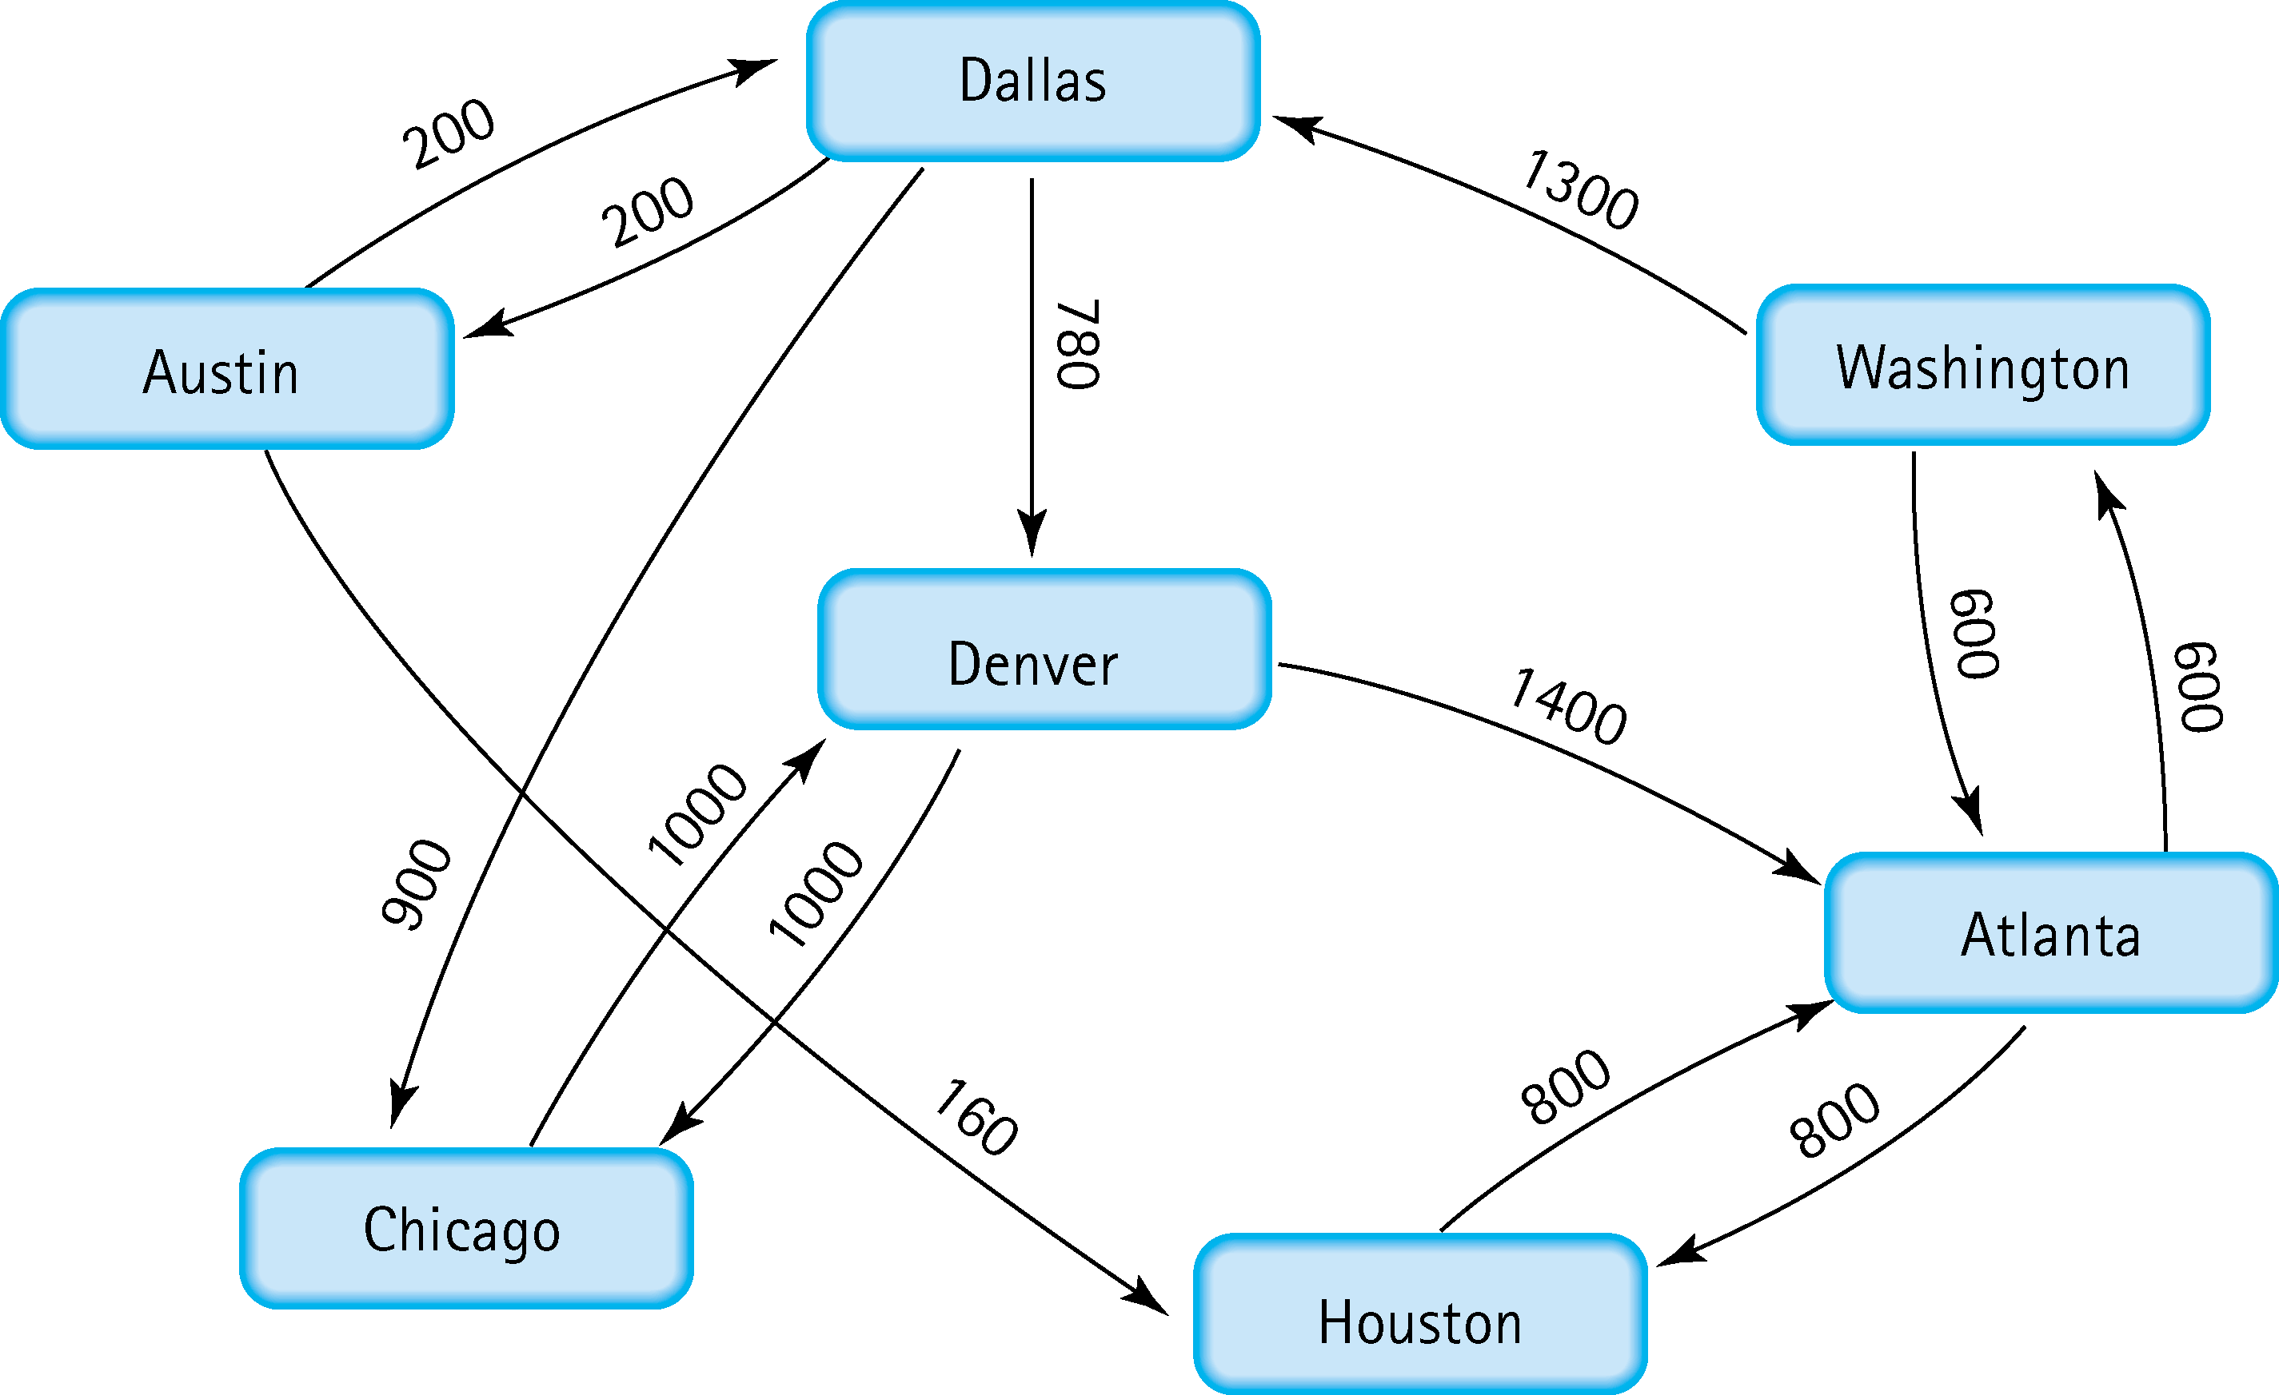
5. Find the shortest distance from Atlanta to every other city
From Atlanta to Washington = 600
From Atlanta to Houston = 800
From Atlanta to Dallas = 600 + 1300 = 1900
From Atlanta to Austin = 1900 + 200 = 2100
From Atlanta to Denver = 1900 + 780 = 2680
From Atlanta to Chicago = 1900 + 900 = 2800

Slide 5
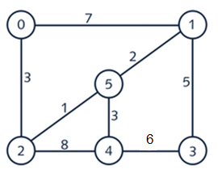


6. Find the minimal spanning tree using Prim’s algorithm. Use
0 as the source vertex . Show the steps.
1
0 5
4 3
2

Slide 6
7. Find the minimal spanning tree using Kruskal’s algorithm.
Show the weights in order and the steps.
0
1
5
2
3
5
2
1
3
3

Slide 7
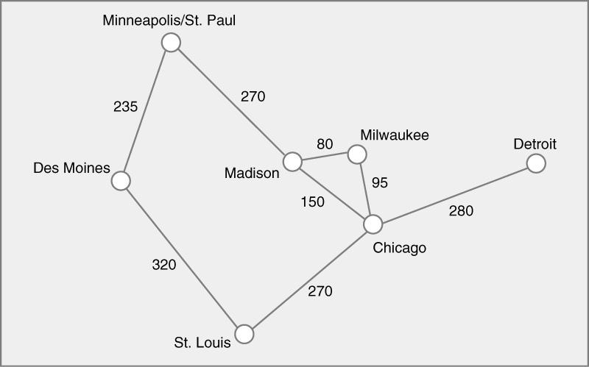
8. Find the minimal spanning tree using the algorithm you prefer. Use
Minneapolis/St. Paul as the source vertex
(Madison Milwaukee)=80 (Milwaukee, Chicago)= 95,
(Madison, Chicago)=150 ( Des Moines, Minneapolis St Paul)= 235
(St. Louis, Chicago)=270 (Minneapolis St. Paul, Madison)=270
(Chicago, Detroit)=280 ( Des Moines, St. Louis)=320
Connecting all edged will result
235
270 80
95
270 280

Slide 8
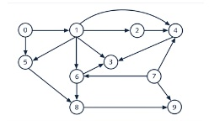
9. List the nodes of the graph in a breadth first topological ordering. Show the
steps using arrays predCount, topologicalOrder and a queue
In deg of each value
In deg(0)-1
(1)-1
(2)-1
(3)=4
(4)-3
(5)-2
In edge (6)-2
(7)-0
(8)-2
(9)-2

Slide 9

10. List the nodes of the graph in a breadth first topological ordering.
0-Start
Start Has two childe node Programming 1 and Discrete Math
Level 1
Start, Programming 1, Descrete math , computer organization and Programming 2
Level 2
2-Start, programming 1, Descret math,Computer Organization and Programming 2 and Algorithms
Level 3
Start, programming 1 ,Descret Math,Operating Systems, High level languages and Algorithm
Final
Start,programming1,Descret math, computer Organization,programming 2, operating system,high level language,compiler,senior service,theory of computation
5- End

